Slide 1

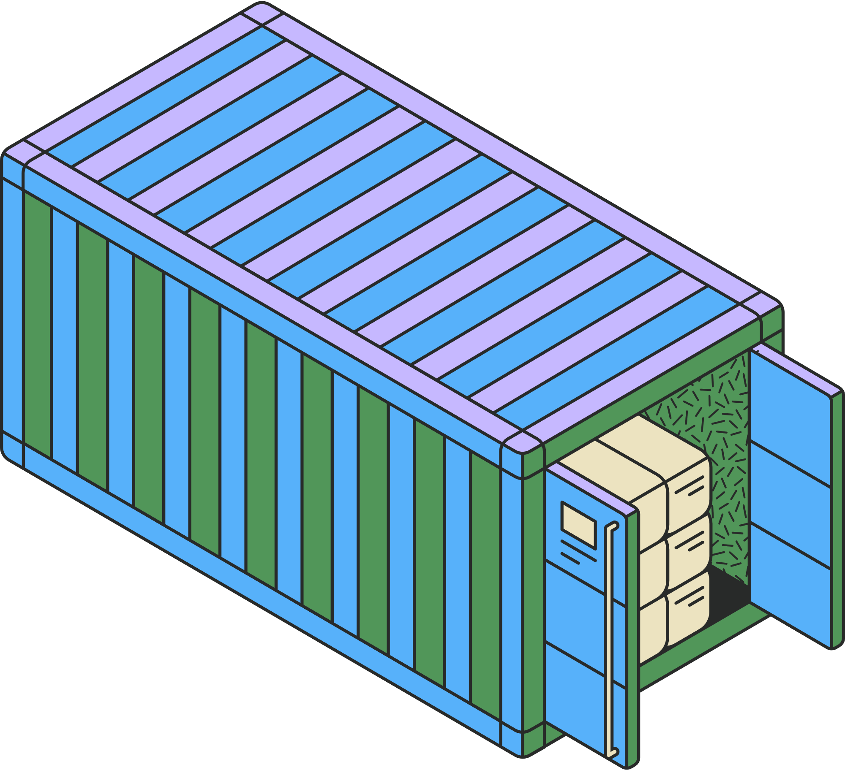





GROUP PROJECT
Efficient Cargo Loading for Humanitarian Aid Delivery
Presented by: Relief Rapid

Slide 2






Meet the Team
CHENG KE XI 212228
THANESH RAO A/L SIMMATHIRI 210887
WU LIQIANG 209759

Slide 3


Topic Outline
1
Original Scenario
6
Algorithm Specification
Importance of Finding an Optimal Solution
2
Analysis of Algorithm Correctness and Time Complexity
Review of Algorithms for Solution Paradigm
7
3
4
Algorithm Design
GitHub Implementation
8
Program Development in Java
5
9
Summary

Slide 4


Original Scenario
The humanitarian aid organization dispatches relief shipments to disaster-stricken areas using a cargo plane. The plane has a maximum weight capacity crucial for safe operations. Each aid cargo item has a weight and a priority value indicating its urgency. The objective is to load the plane to maximize the total priority value without exceeding its weight limit, ensuring efficient and effective aid delivery to save lives.

Slide 5
Original Scenario
Item | Weight (kg) | Priority Value
Non-perishable food | 700 | 60
Bottled Water | 400 | 50
First Aid Kit | 300 | 70
Insulated Blankets | 500 | 40
Emergency Shelter | 800 | 80
Baby Formula and Food | 200 | 55
Personal Hygiene Items | 150 | 65
Water Purification System | 300 | 75
Portable Toilet | 250 | 70
Medical Supplies | 350 | 65
Communication Devices | 200 | 60
Fire-starting Supplies | 100 | 45
Tools | 400 | 40
Sanitation Supplies | 200 | 55
Pet Supplies | 300 | 50
Entertainment and Comfort Items | 150 | 45
Safety Gear | 250 | 60
Purpose
Efficient and effective delivery of critical supplies to mitigate suffering and save lives in disaster-affected areas by maximizing total priority value of aid cargo without exceeding 4000 kg weight limit.
Cargo Plane Weight Capacity: 4000 kg
Aid Items: Specific weight and priority value
Goal
Load plane to maximize priority value
Ensure total weight ≤ 4000 kg

Slide 6
Importance of Finding an Optimal Solution
Maximizing Aid Effectiveness: Prioritizes critical items like medical kits and food for immediate relief, reducing suffering and saving lives.
Efficient Resource Utilization: Uses plane capacity fully, maximizing the amount of aid delivered per trip and improving overall mission impact.
Operational Cost Management: Reduces trips, saving on fuel and operational costs, allowing more funds for supplies and aid workers.
Timely Delivery: Ensures quick delivery of essential supplies, stabilizing disaster areas faster and aiding quicker recovery.
Transparency and Accountability: Efficient distribution maintains donor trust, ensuring continued support and enhancing the organization's reputation.

Slide 7
Review of Algorithms for Solution Paradigm
DIVIDE AND CONQUER
DYNAMIC PROGRAMMING
SORTING
Strengths
Simple implementation and understanding.
Weaknesses
Does not guarantee optimal solution. May overlook high-priority items.
Strengths
Breaks down complex problems into manageable subproblems.
Weaknesses
Doesn't naturally combine subproblems into an optimal global solution. Limited effectiveness for cargo loading.
Strengths
Guarantees optimal solution by considering all combinations. Avoids redundant calculations through memoization.
Weaknesses
Memory-intensive and complex. Increased computational overhead.

Slide 8
Review of Algorithms for Solution Paradigm
GREEDY ALGORITHM
GRAPH ALGORITHMS
Strengths
Fast and easy to implement. Works well for sorted items by value-to-weight ratio.
Weaknesses
Doesn't always produce optimal solution. May overlook better solutions by focusing on immediate gains.
Strengths
Represents problems visually. Can find paths optimizing both weight and value.
Weaknesses
More complex and less intuitive for knapsack-type problems. Requires more expertise and computational resources.

Slide 9
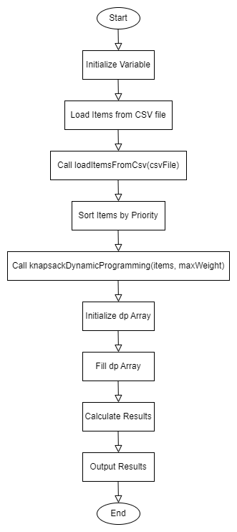
Algorithm Design

Slide 10
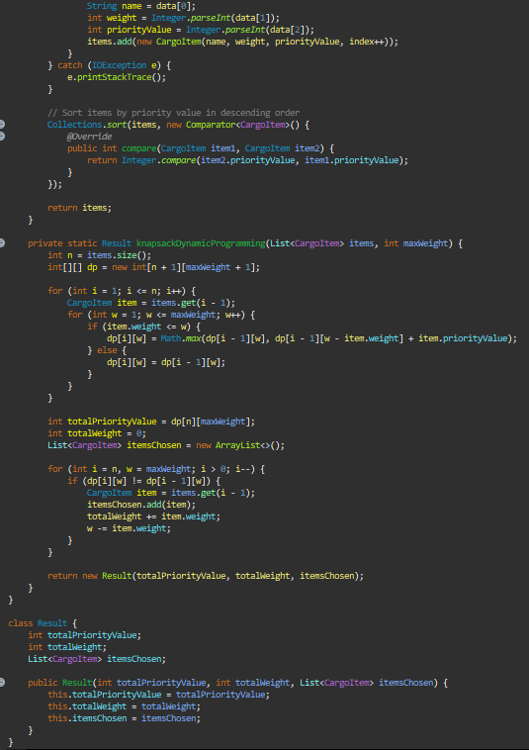
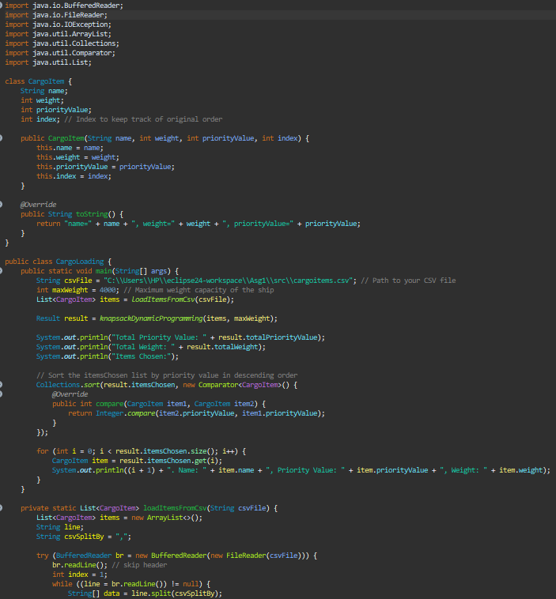
Program Development in Java

Slide 11
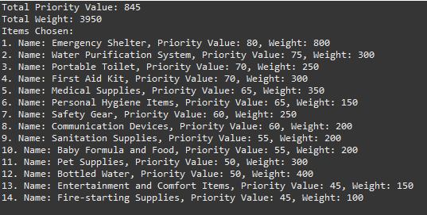
Output

Slide 12
Algortihm Specification
Problem Statement
Given a set of cargo items, each with a weight and a priority value, and a maximum weight capacity for the cargo ship, the objective is to maximize the total priority value of the items loaded onto the ship without exceeding its weight capacity.
Input :
cargoItems: A list of cargo items, each containing the following attributes:
name: Name of the cargo item (String)
weight: Weight of the cargo item in kilograms (Integer)
priorityValue: Priority value of the cargo item (Integer)
maxWeight: Maximum weight capacity of the cargo ship in kilograms (Integer)
Output :
totalPriorityValue: The maximum total priority value achievable by loading cargo items onto the ship (Integer)
totalWeight: The total weight of the cargo items loaded onto the ship (Integer)
itemsChosen: A list of cargo items chosen for loading onto the ship, along with their details (List of CargoItem objects)

Slide 13
Analysis of Algorithm Correctness and Time Complexity
BASE CASE INITIALIZATION
FINAL SOLUTION CONSTRUCTION
The DP table (dp) is initialized with zeros.
This means if there are no items or the weight capacity is zero, the maximum achievable priority value is zero.
This initialization is correct as without any items or capacity, no value can be accumulated.
After filling DP table, trace back to find included items.
If dp[i][w] != dp[i−1][w], item i is included.
Ensures maximum priority value without exceeding weight capacity.

Slide 14
Analysis of Algorithm Correctness and Time Complexity
Recursive Relation
The algorithm correctly implements the recurrence relation for the 0/1 Knapsack Problem.
For each item i and weight w:
If item's weight ≤ w:
dp[i][w] = max(dp[i−1][w], dp[i−1][w−item.weight] + item.priorityValue)
If item's weight > w:
dp[i][w] = dp[i−1][w]
This ensures that the DP table stores the maximum priority value for each subproblem.

Slide 15
Time Complexity
Initialization
Initializing the DP table dp with dimensions (n+1) x (maxWeight+1) takes O(n×W) time.
Each cell in the DP table is set to zero initially.
Filling DP Table
The DP table is filled by iterating over each item and each possible weight capacity.
For each item i and capacity w, constant time work is done to update the DP table.
This filling process involves O(n×W) time.
Reconstruction of Solution
After filling the DP table, the algorithm traces back through the table.
This involves a single pass through the items, taking O(n) time.

Slide 16
Analysis of Algorithm Correctness and Time Complexity
The time complexity is analyzed based on three main phases:
initialization, filling the DP table, and reconstructing the solution.
INITIALIZATION
FILLING THE DP TABLE
RECONSTRUCTING THE SOLUTION
O(N×W)
O(N×W)
O(N)
OVERALL TIME COMPLEXITY
O(N×W) + O(N×W) + O(N) = O(2N×W+N)
O(2N×W+N) = O(N×W)

Slide 17
Analysis of Algorithm Correctness and Time Complexity
BEST CASE
AVERAGE CASE
WORST CASE
O(N×W)
O(N×W)
O(N×W)
The number of operations depends on the total number of items n and the weight capacity W.

Slide 18
Analysis of Space Complexity
SPACE COMPLEXITY : O(N×W)
Requires space proportional to the number of items (n) and weight capacity (W)
Both time and space complexities: O(n×W), ensuring efficient and optimal solution for the 0/1 Knapsack Problem.

Slide 19
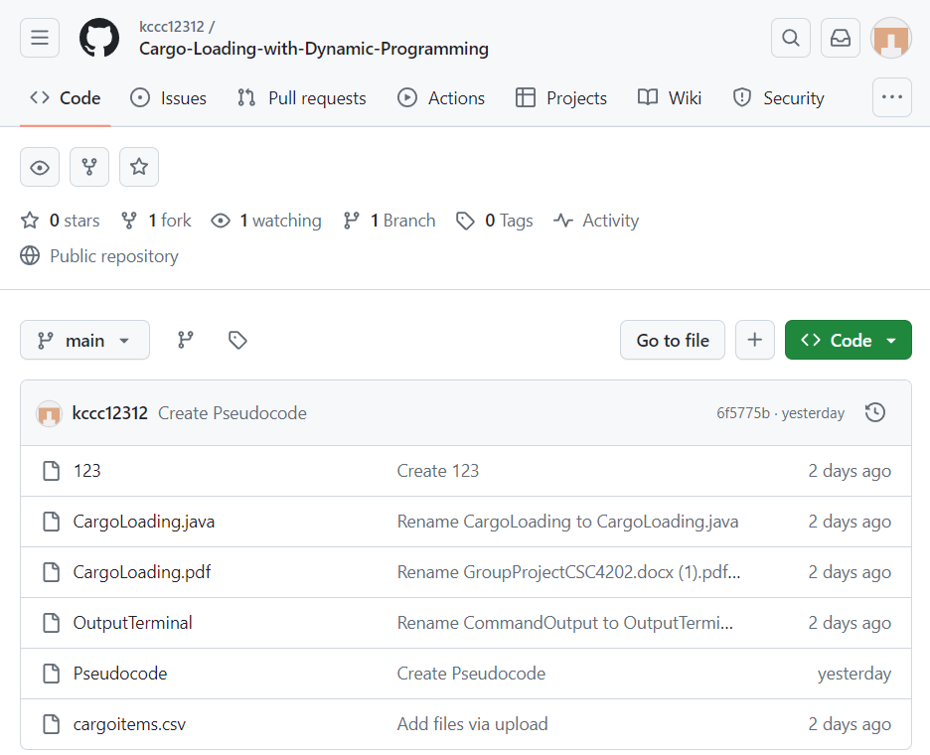
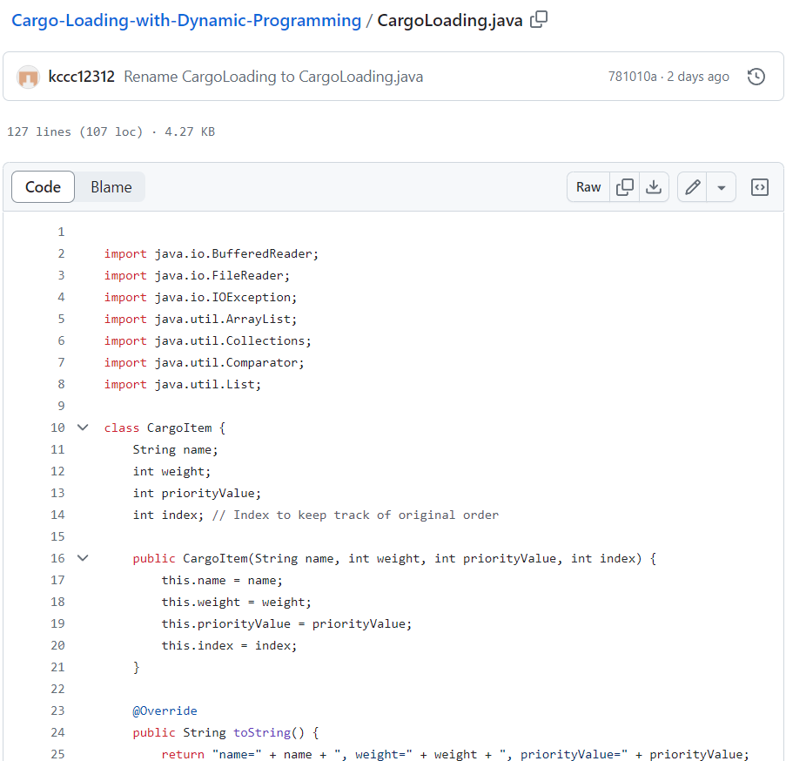
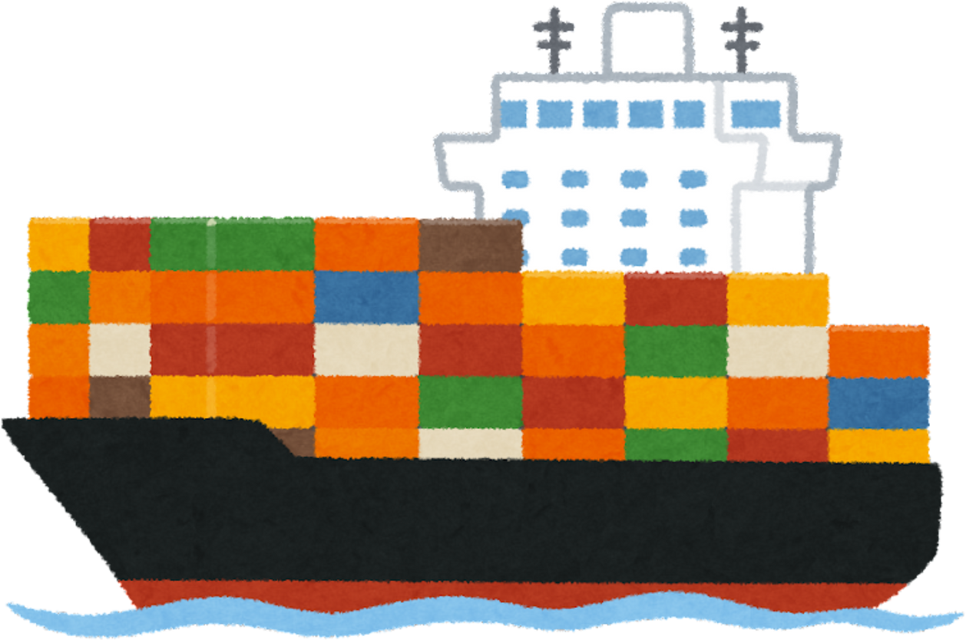
GitHub Implementation

Slide 20
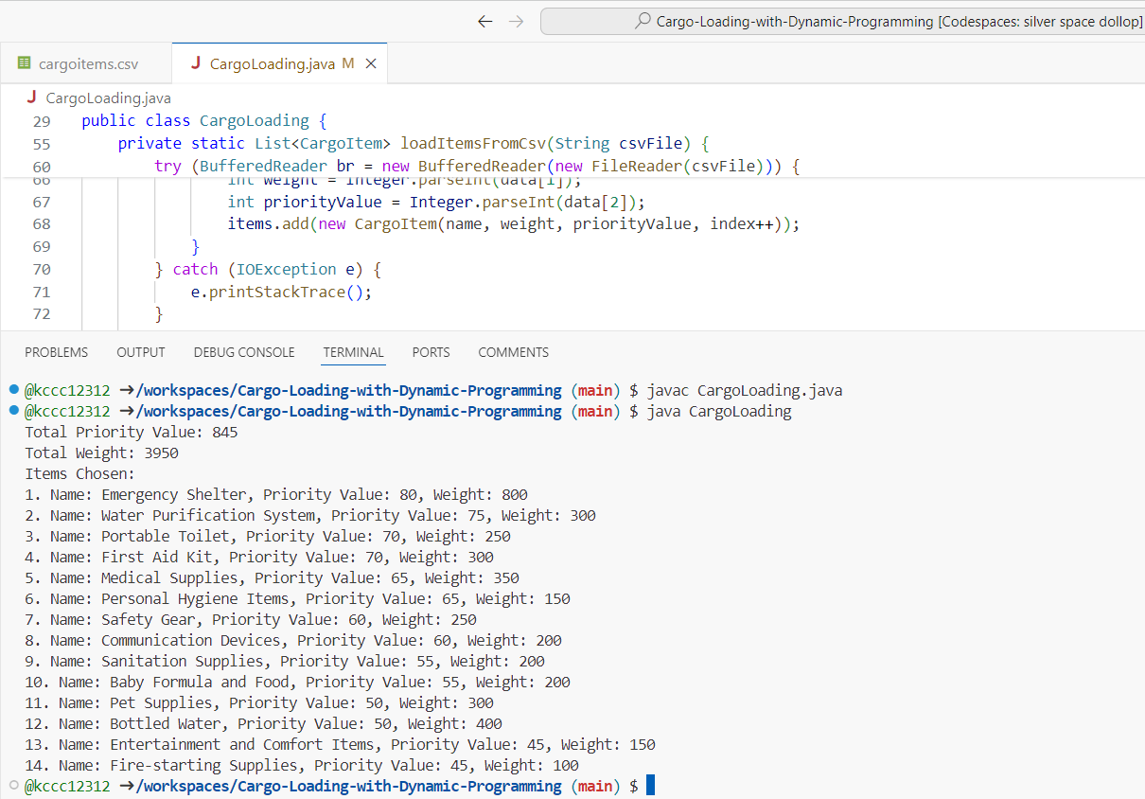
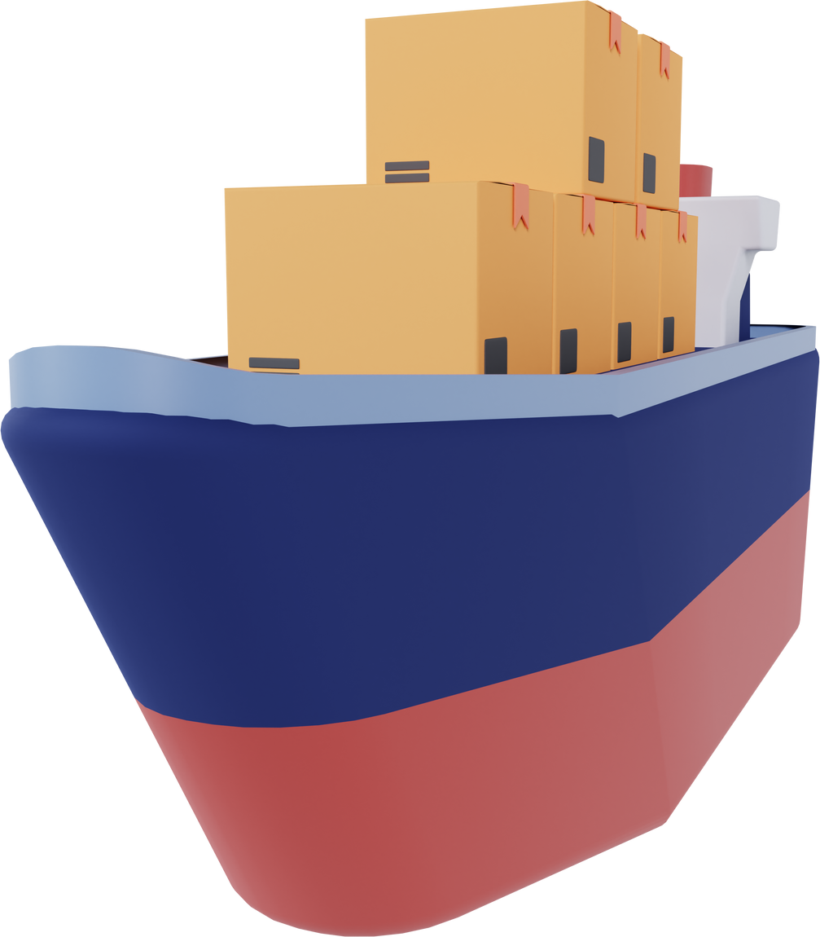
Run in CodeSpace

Slide 21

Conclusion
THIS PROJECT SUCCESSFULLY ADDRESSES THE EFFICIENT CARGO LOADING PROBLEM FOR HUMANITARIAN AID DELIVERY, PROVIDING A ROBUST AND OPTIMAL SOLUTION USING DYNAMIC PROGRAMMING. THE DEVELOPED ALGORITHM AND ITS IMPLEMENTATION ENSURE THAT THE HIGHEST PRIORITY ITEMS ARE DELIVERED WITHIN THE WEIGHT CONSTRAINTS OF THE CARGO PLANE, THEREBY ENHANCING THE EFFICIENCY AND IMPACT OF THE RELIEF EFFORTS.

Slide 22
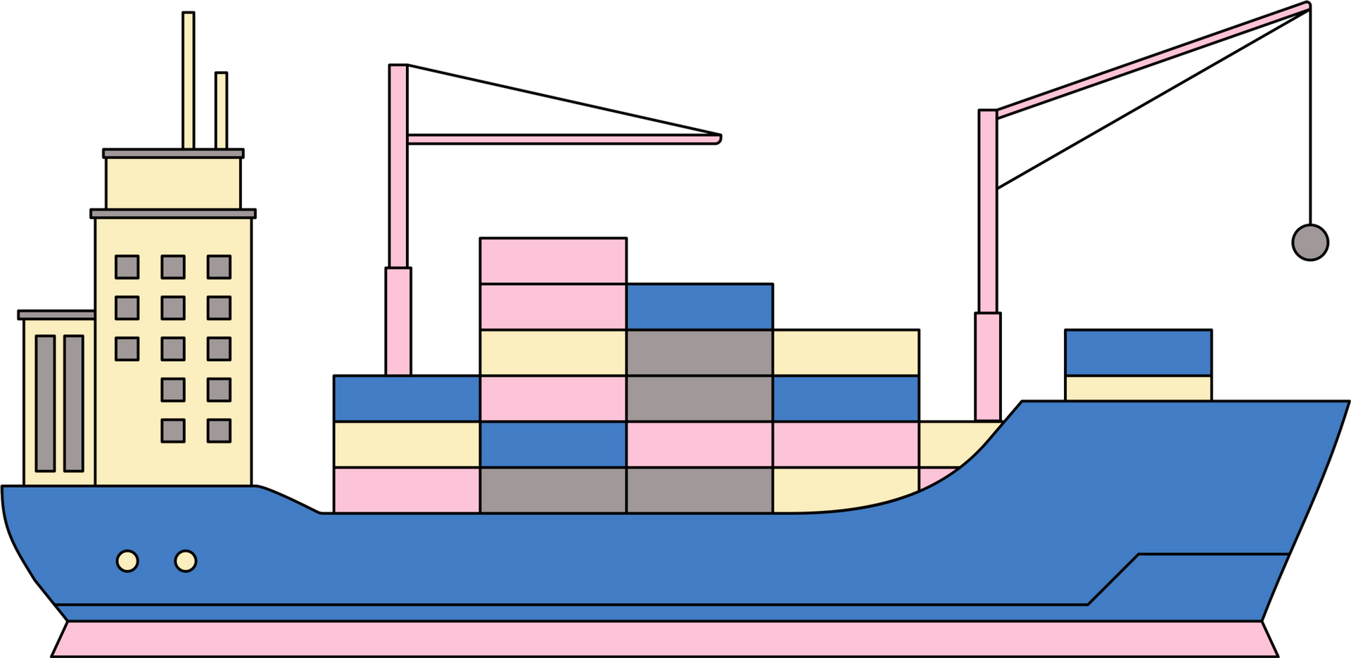
Thank you for listening!

